Slide 1

Tobacco Control In Youth Guide: Mrs. Sneha Varur
Name | USN | Roll No.
Somashekhar M. Kinagi | 01FE22BCS063 | 12
Vishwa M. Badachi | 01FE22BCS065 | 13
Fardeen Vaddo | 01FE22BCS074 | 14
Sai Satya B. V. | 01FE22BCS076 | 15

Slide 2

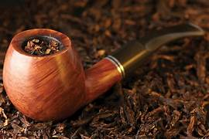

Introduction
fig 1.1
fig 1.2
Tobacco is an addictive preparation made out of nicotine-rich leaves native to tropical America.
It kills about 50% of its users.

Slide 3


Introduction
fig 1.3
fig 1.4
About 1.3 billion people worldwide
use tobacco products to get rid of stress
More than 80% of people using tobacco
products are in low and
middle-income countries

Slide 4

Case Study : The Story of Terrie Hall
Terrie Hall was born in 1960 in North Carolina, USA.
She started smoking at the age of 13 and by the age of 17, she was smoking up to two packs a day.
In her mid-20s, Terrie began to experience health issues, including a persistent cough and frequent colds.
In her late 30s, Terrie developed a hoarse voice and throat pain, but she did not seek medical attention immediately.

Slide 5
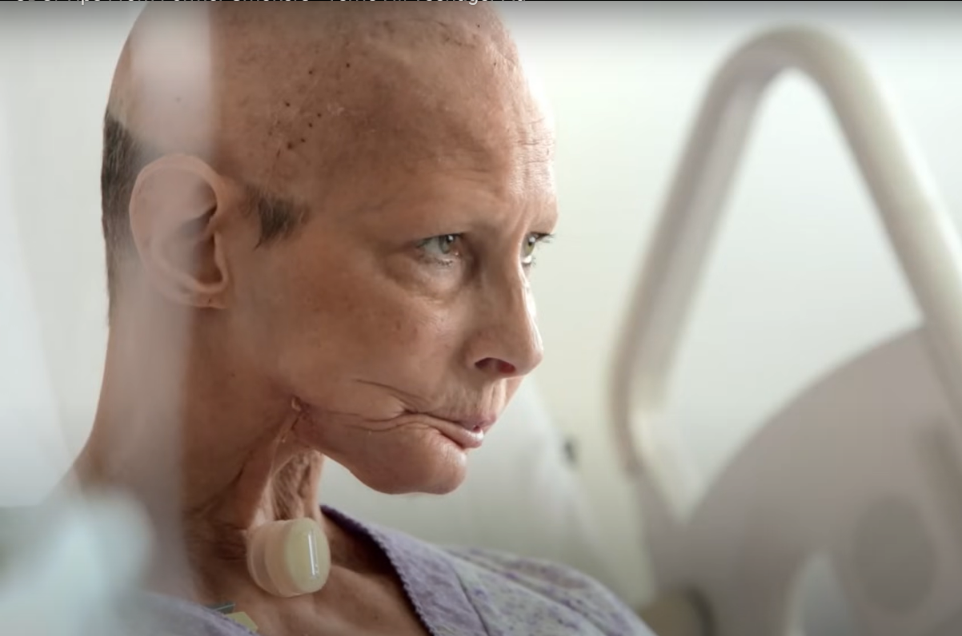
Case Study: The Story of Terrie Hall (Health Decline)
At the age of 40, Terrie was diagnosed with oral and throat cancer.
She underwent numerous surgeries, including the removal of her voice box.
This left her with a stoma (an opening in her neck) and the need to use an artificial voice box to speak
Despite these life-altering procedures, Terrie continued to smoke for a brief period before eventually quitting.

Slide 6

Case Study: The Story of Terrie Hall (Life after Diagnosis)
She had to adapt to breathing through a stoma.
Her appearance was altered, and she faced physical and emotional challenges.
Terrie Hall became a prominent anti-smoking advocate and started spreading awareness regarding the dangers of smoking.
Terrie Hall passed away on September 16, 2013, at the age of 53, due to complications from cancer.

Slide 7
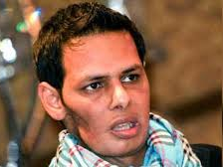

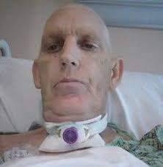
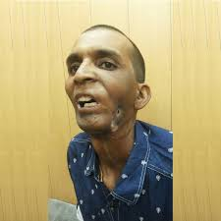
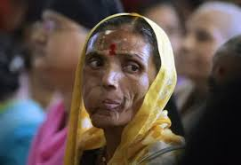
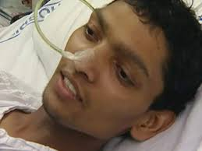
Introduction

Slide 8
Alignment with the Target
Target: 3.A Implement the WHO Framework Convention on Tobacco Control
Analyzing the selected dataset may help us improve the following implementations
Pictorial health warnings work
Bans on tobacco advertising to lower consumption
Managing taxes to reduce tobacco usage effectively
Tobacco users need help to quit
Illicit trade of tobacco products must be stopped

Slide 9
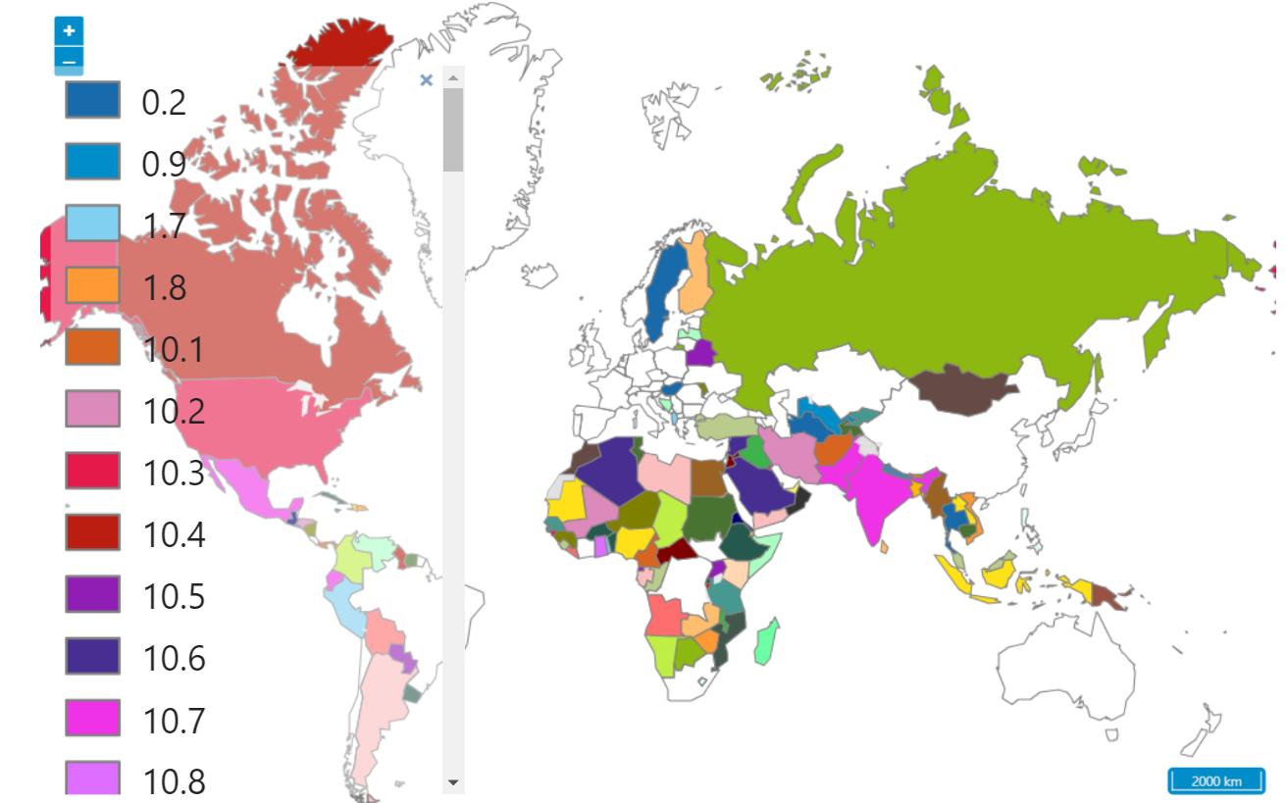
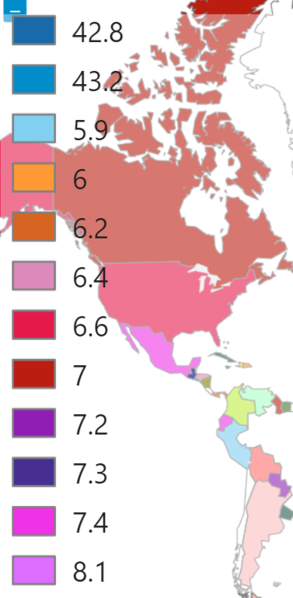
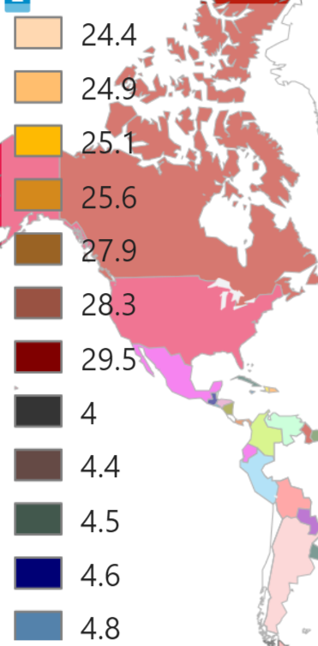
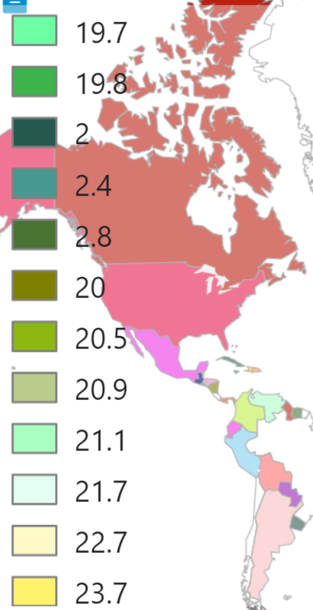
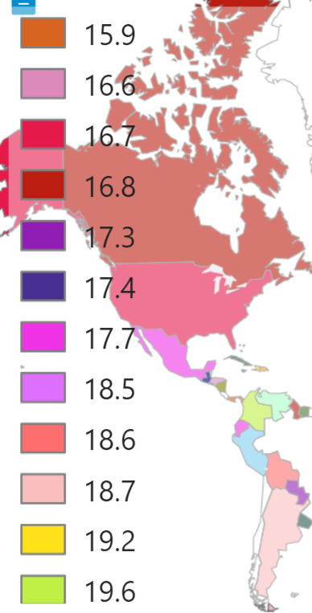
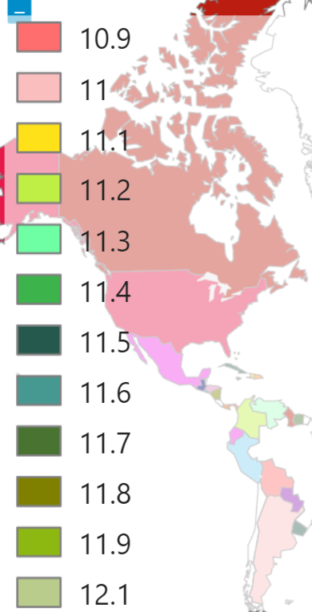
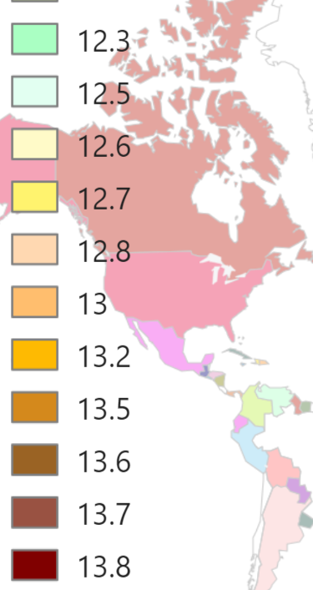
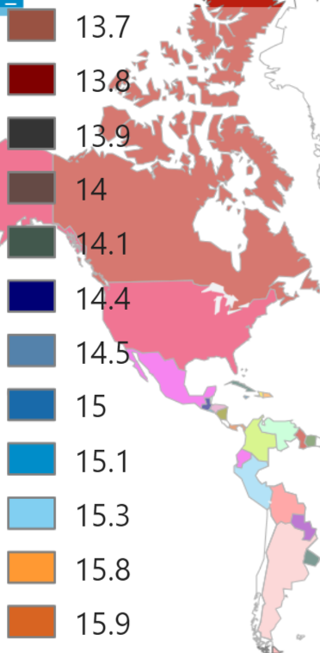
Prevalence of Current Tobacco Use Among Adolescents (%)
fig 3
Source: www.who.int

Slide 10
Problem Statement
EDA for effective strategies to curb initiation and consumption among adolescents, and protect their well-being.
Analyze the cause of youths getting attracted to tobacco or going in a path of consuming tobacco.
Improving or bringing in some new measures to the WHO conventions to curtail use of tobacco in youths/adolescents.

Slide 11
Data Description
Source of the data : data.gov.in
Size of the data = 108 (Rows) x 59 (Columns)
Attributes :
'State/UT',
'Area',
'Ever tobacco users (%)',
'Current tobacco users (%)',
'Ever tobacco smokers (%)',
'Current tobacco smokers (%)',
'Ever cigarette users (%)',
'Current cigarette users (%)',
'Ever bidi users (%) ',
'Current bidi users (%)',
'Ever smokeless tobacco users (%)',
'Current smokeless tobacco users (%)',
'Ever users of paan masala together with tobacco (%)',
'Never cigarette smokers susceptible to cigarette use in future (%)',
'Median age of initiation of Cigarette (in years)',
'Median age of initiation of Bidi (in years)',
'Median age of initiation of smokeless tobacco (in years)',

Slide 12
Data Description
'Awareness about e-cigarette (%)',
'Ever e-cigarette use (%)',
'Ever tobacco smokers who quit in last 12 months (%)',
'Current tobacco smokers who tried to quit smoking in the past 12 months (%)',
'Current tobacco smokers who wanted to quit smoking now (%)',
'Ever smokeless tobacco users who quit in last 12 months (%)',
'Current smokeless tobacco users who tried to quit tobacco in the past 12 months (%)',
'Current smokeless tobacco users who wanted to quit tobacco now (%)',
'Exposure to tobacco smoke at home/public place (%)',
'Exposure to tobacco smoke at home (%)',
'Exposure to tobacco smoke inside any enclosed public places (%)',
'Exposure to tobacco smoke at any outdoor public places (%)',
'Students who saw anyone smoking inside the school building or outside school property (%)',
'Major source of tobacco product- Cigarette: Store (%)',
'Major source of tobacco product- Cigarette: Paan shop (%)',
'Major source of tobacco product- Bidi: Store (%)',
'Major source of tobacco product- Bidi: Paan shop (%)',
'Major source of tobacco product- Smokeless tobacco: Store (%)',
'Major source of tobacco product- Smokeless tobacco: Paan shop (%)',
'Current cigarette smokers who bought cigarettes from a store, paan shop, street vendor, or vending machine (%)',
'Current bidi smokers who bought bidi from a store, paan shop, or street vendor (%)',
'Refused sale of cigarette because of age in past 30 days (%)',
'Refused sale of bidi because of age in past 30 days (%)',
'Refused sale of smokeless tobacco because of age in past 30 days (%)',

Slide 13
Data Description
'Bought Cigarette as individual sticks in past 30 days (%)',
'Bought Bidi as individual sticks in past 30 days (%)',
'Students who noticed anti-tobacco messages anywhere in past 30 days (%)',
'Students who noticed anti-tobacco messages in mass media in past 30 days (%)',
'Students who noticed anti-tobacco messages at sporting, fairs, concerts, community events or social gatherings in past 30 days (%)',
'Students who noticed health warnings on any tobacco product/cigarette packages in past 30 days (%)',
'Students who saw tobacco advertisements anywhere in past 30 days (%)',
'Students who saw anyone using tobacco on mass media in past 30 days (%)',
'Students who noticed cigarette advertisements/promotions at point of sale in past 30 days (%)',
'Students who were taught in class about harmful effects of tobacco use during past 12 months (%)',
'Students who thought it is difficult to quit once someone starts smoking tobacco (%)',
'Students who thought other people’s tobacco smoking is harmful to them (%)',
'Students who favored ban on smoking inside enclosed public places (%)',
'Students who favored ban on smoking at outdoor public places (%)',
'School heads aware of COTPA, 2003 (%)',
'Schools authorized by the state government to collect fine for violation under Section-6 of the COTPA, 2003 (%)',
'Schools followed ‘tobacco-free school’ guidelines (%)',
'Schools aware of the policy for displaying ‘tobacco-free school’ board (%)’

Slide 14
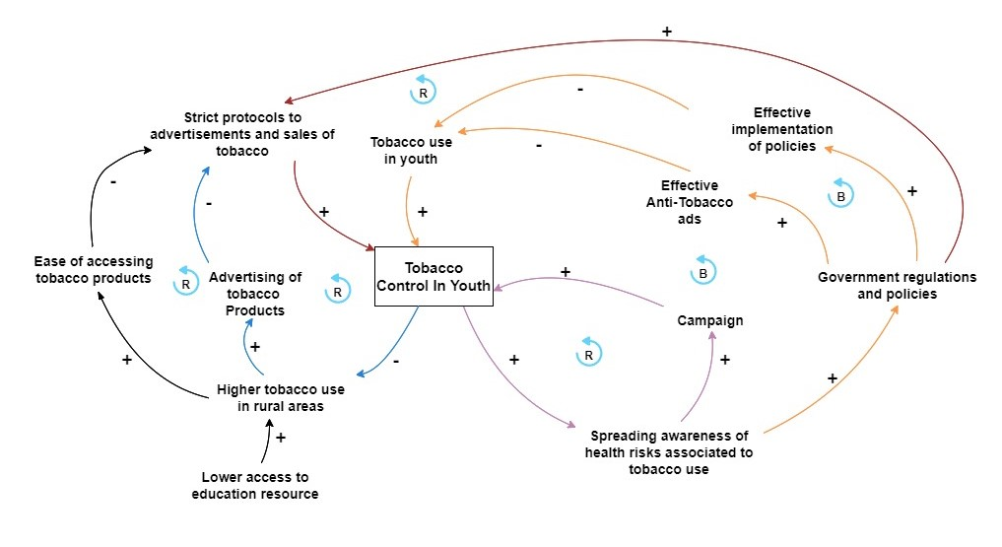
Causal Loop Diagram

Slide 15
Data Pre-Processing
The whole data was numeric type
The data had some attributes which were of object type and these attributes consisted of some special characters(noisy data)
Attributes consisting of noisy data:
Median age of initiation of Cigarette (in years)
Median age of initiation of Bidi (in years)
Median age of initiation of smokeless tobacco (in years)
Bought Cigarette as individual sticks in past 30 days (%)
Students who saw anyone using tobacco on mass media in past 30 days (%)

Slide 16
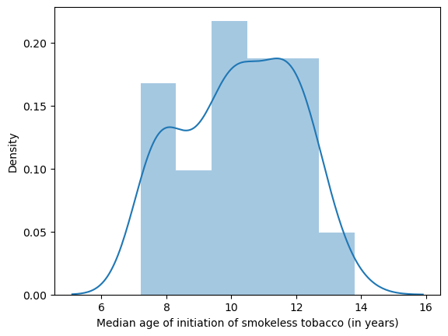
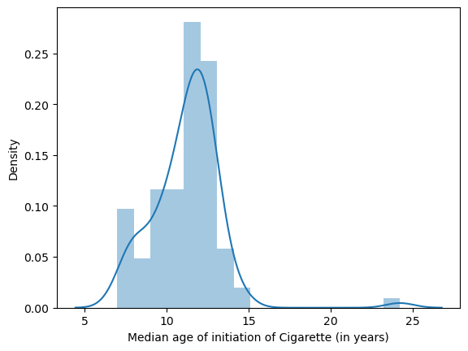
Data Pre-Processing
These attributes were converted to numeric type using the “to_numeric()” function replacing the noisy data with null values.
The null values were further replaced with appropriate central tendencies by analyzing the normal distribution of the attribute.
(normal) mean
(Skewed) median

Slide 17
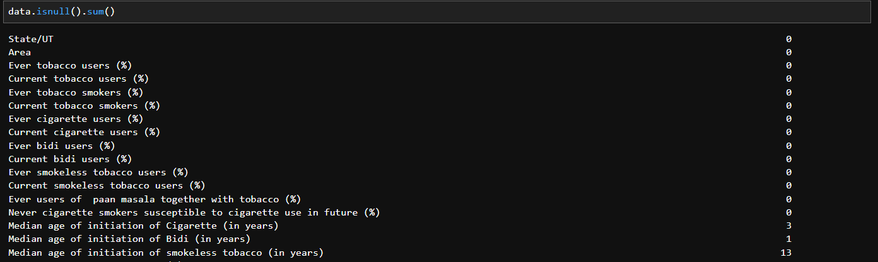
Data Pre-Processing
Before Pre-Processing:

Slide 18
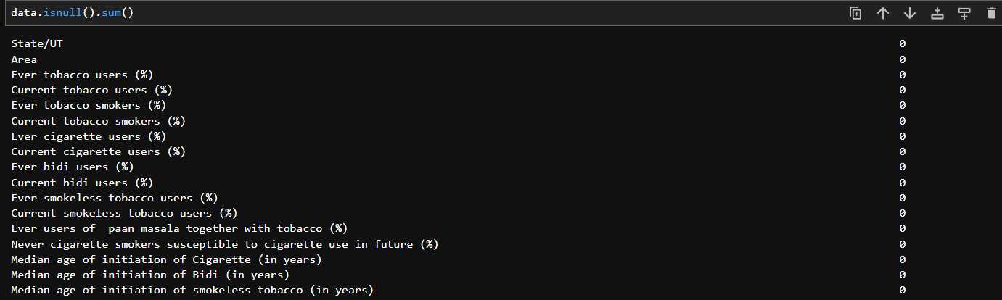
Data Pre-Processing
After Pre-Processing:

Slide 19
INFERENCES

Slide 20
Inference 1 :
Which states have the highest and lowest Number of current tobacco users in the country?

Slide 21
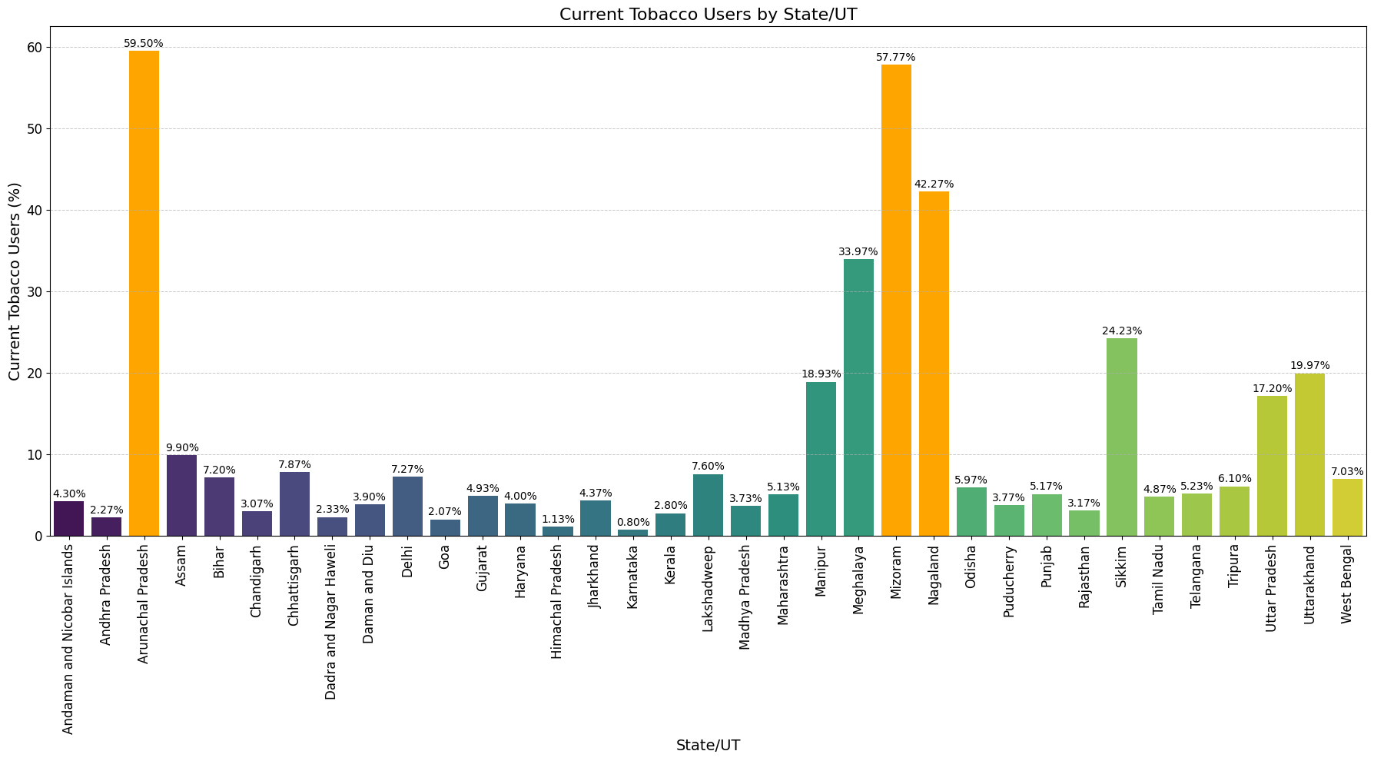
fig 1

Slide 22

Inference 1 :
The Bar plot can highlight which State has the highest and the lowest number of current tobacco users ( in terms of percentage ).
We can see that Arunachal Pradesh has the highest percentage of current tobacco users and Karnataka has the lowest percentage of current tobacco users

Slide 23
Inference 2 :
Which States or union territories have the highest and lowest percentage of tobacco quitters in the last 1 year?

Slide 24
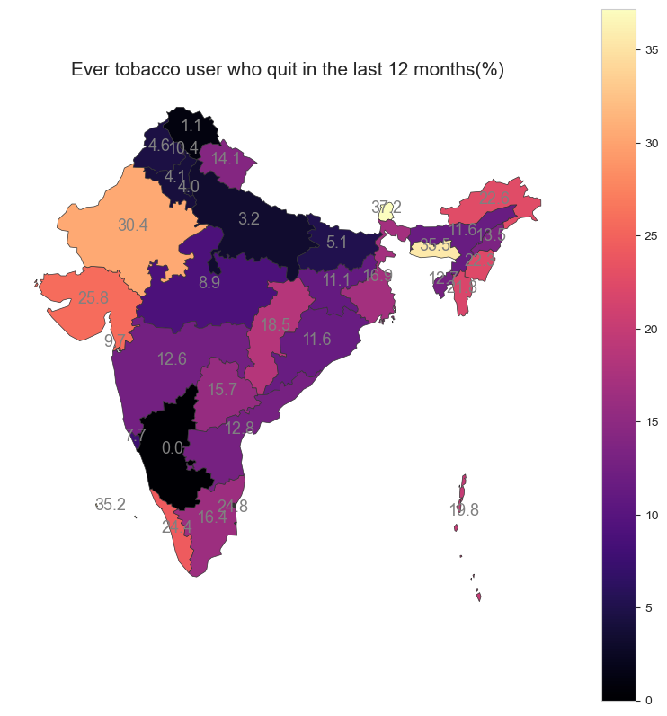
fig 2

Slide 25
Inference 2 :
The geographical heatmap shows the percentage of tobacco quitters in the last 12 months in every state
Inference:
States such as Himachal Pradesh, Punjab, Haryana, Uttarakhand and Uttar Pradesh in the north and Karnataka in the south have the lowest percentage of users who quit in the last 12 months.
Whereas, Sikkim, and Meghalaya in the east and Rajasthan and Gujarat in the west have the highest percentage of users who quit in the last 12 months.

Slide 26
Inference 3 :
In which states did the use of tobacco products decrease drastically?

Slide 27

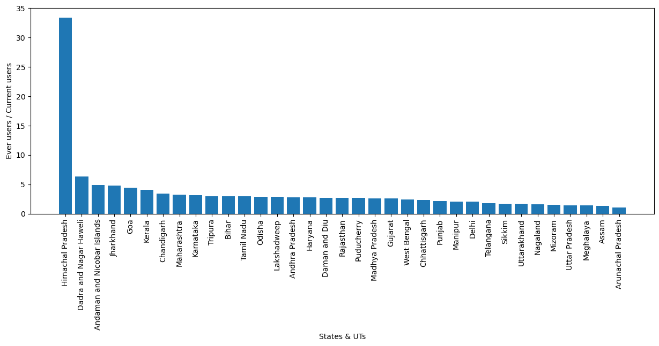
fig 3

Slide 28
Inference 3 :
The bar plot shows the ratio between the ‘Ever tobacco users’ and ‘Current tobacco users’ corresponding to all the states.
Inference: In Himachal Pradesh, there is only 1 current tobacco user for every 35 overall tobacco users. It is the highest ratio among all the states and no other state is close to this ratio.
From the above inference, we can infer that studying the methods implemented by Himachal Pradesh to decrease tobacco usage and enforce them in other states may curb the initiation of tobacco throughout the country.

Slide 29
Inference 4 :
Which area has the highest percentage of tobacco users?

Slide 30
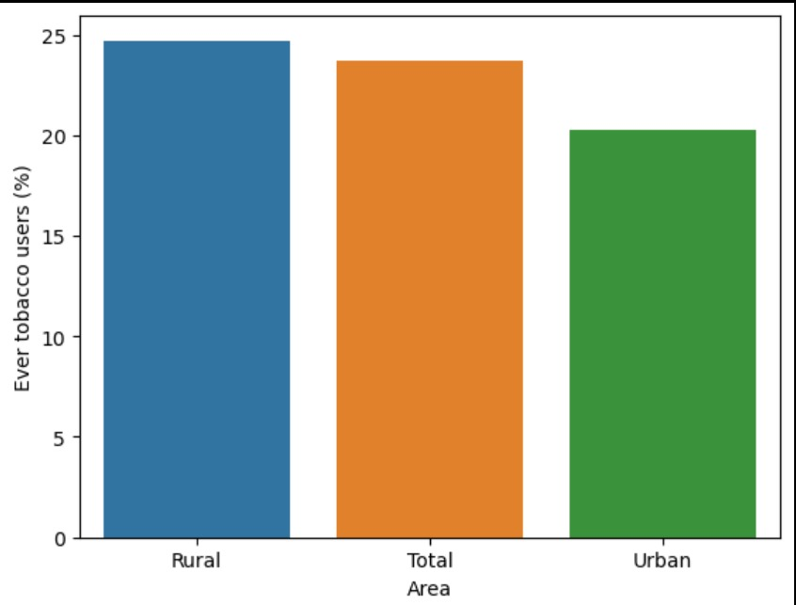
fig 4

Slide 31
Inference 4 :
Inference: The Bar plot can highlight which Region has higher or lower tobacco users.
Reasoning:
From the graph we can see that tobacco usage in rural areas is more than in urban areas.
Rural communities have less access to educational resources about the health risks associated with tobacco use. This lack of awareness contributes to higher rates of smoking.
fig 4

Slide 32
Inference 5 :
How does exposure to tobacco in mass media influence the tobacco use behaviour of students?

Slide 33
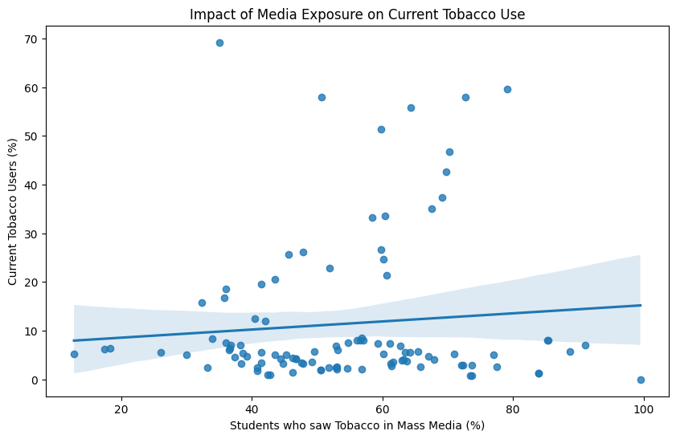
fig 5

Slide 34
Inference 5 :
Current Tobacco Usage vs. Impact of Media Exposure:
The scatter plot shows a positive correlation between exposure to tobacco advertising and the percentage of current tobacco users.
Inference: Increased exposure to tobacco advertising is associated with higher tobacco usage among students.
What can be done?
Stricter regulations on tobacco advertising, especially in media accessible to youths, could help lower usage rates

Slide 35
Inference 6 :
In which age group do most people start smoking cigarettes?

Slide 36
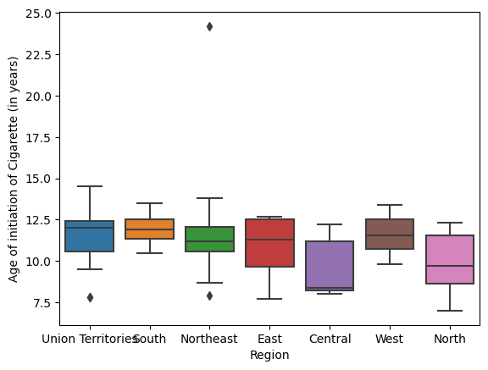
fig 6

Slide 37
Inference 6 :
The boxplot shows the relation between the Age of initiation of cigarettes and regions of India.
Inference: The age band of 10 to 12.5 years is the age group where most people start smoking. However, it is even lower in central and north India.

Slide 38
Conclusion
The analysis of tobacco usage among youth reveals critical insights that necessitate immediate action. Tobacco use remains a significant health risk, especially prevalent in low and middle-income countries, with a substantial portion of users starting at a young age.
From the data analyzed:
High Prevalence Areas: Rural areas exhibit higher tobacco usage compared to urban areas, indicating a need for targeted education and intervention programs in these regions.
Media Influence: There is a strong positive correlation between exposure to tobacco advertising and increased usage among students, suggesting that stricter regulations on tobacco advertisements, especially those accessible to youth, are imperative.
Successful Quit Strategies: States like Himachal Pradesh have shown notable success in reducing tobacco usage. Understanding and replicating their strategies could be beneficial for other regions.
Age of Initiation: Most individuals start smoking between the ages of 10 to 12.5 years, which points to the necessity for preventive measures to be introduced at an even younger age.

Slide 39
Recommendations
Enhanced Education Programs: Implement comprehensive educational campaigns in schools, particularly in rural areas, to raise awareness about the risks of tobacco use.
Stricter Advertising Regulations: Enforce more rigorous controls on tobacco advertising in media, especially those that target or are accessible to young people.
Support for Quitting: Increase support and resources for youth who wish to quit smoking, including counseling and quit line services.
Policy Enforcement: Strengthen the enforcement of existing tobacco control laws and policies, particularly those that restrict sales to minors and mandate smoke-free environments.
Community Engagement: Involve community leaders and organizations in promoting anti-tobacco initiatives and creating a supportive environment for tobacco-free lifestyles.
By addressing these key areas, we can work towards a future with reduced tobacco use among adolescents, leading to healthier communities and a decrease in the burden of tobacco-related diseases.

Slide 40
References
World Health Organisation(WHO): https://www.who.int/
Centres for Disease Control and Prevention: https://www.cdc.gov/tobacco/index.html
Website: data.gov.in (https://data.gov.in/catalog/global-youth-tobacco-survey-gyts-4)

Slide 41
Thank You

